Slide 1
Solutions II
(Solutions/ Molarity)
Applications & Calculations
Dr. Ron Rusay

Slide 2
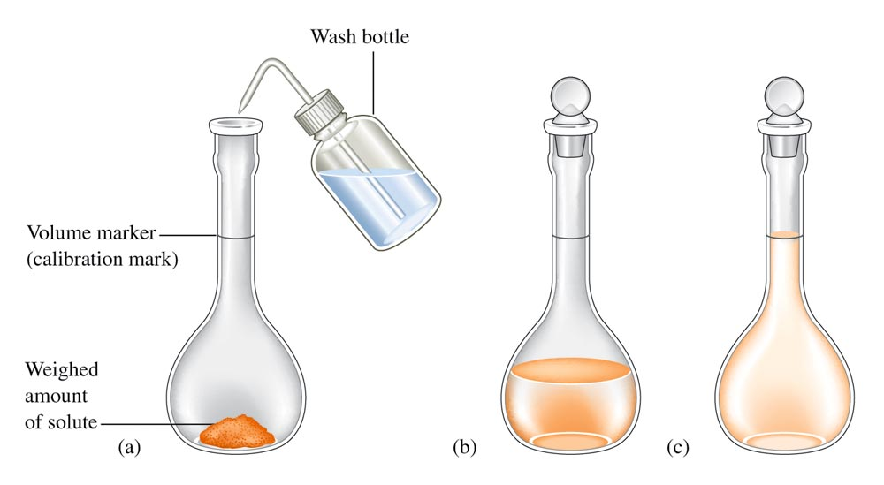
Preparing a Standard Solution of a Targeted Molarity, M (mol/L)
250.00 mL
? grams KCl

Slide 3
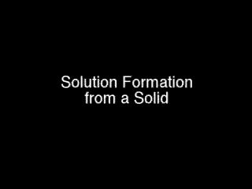

Preparation of Solutions used in chemistry
Molarity (M) = Moles solute / Liter (Solution)

Slide 4
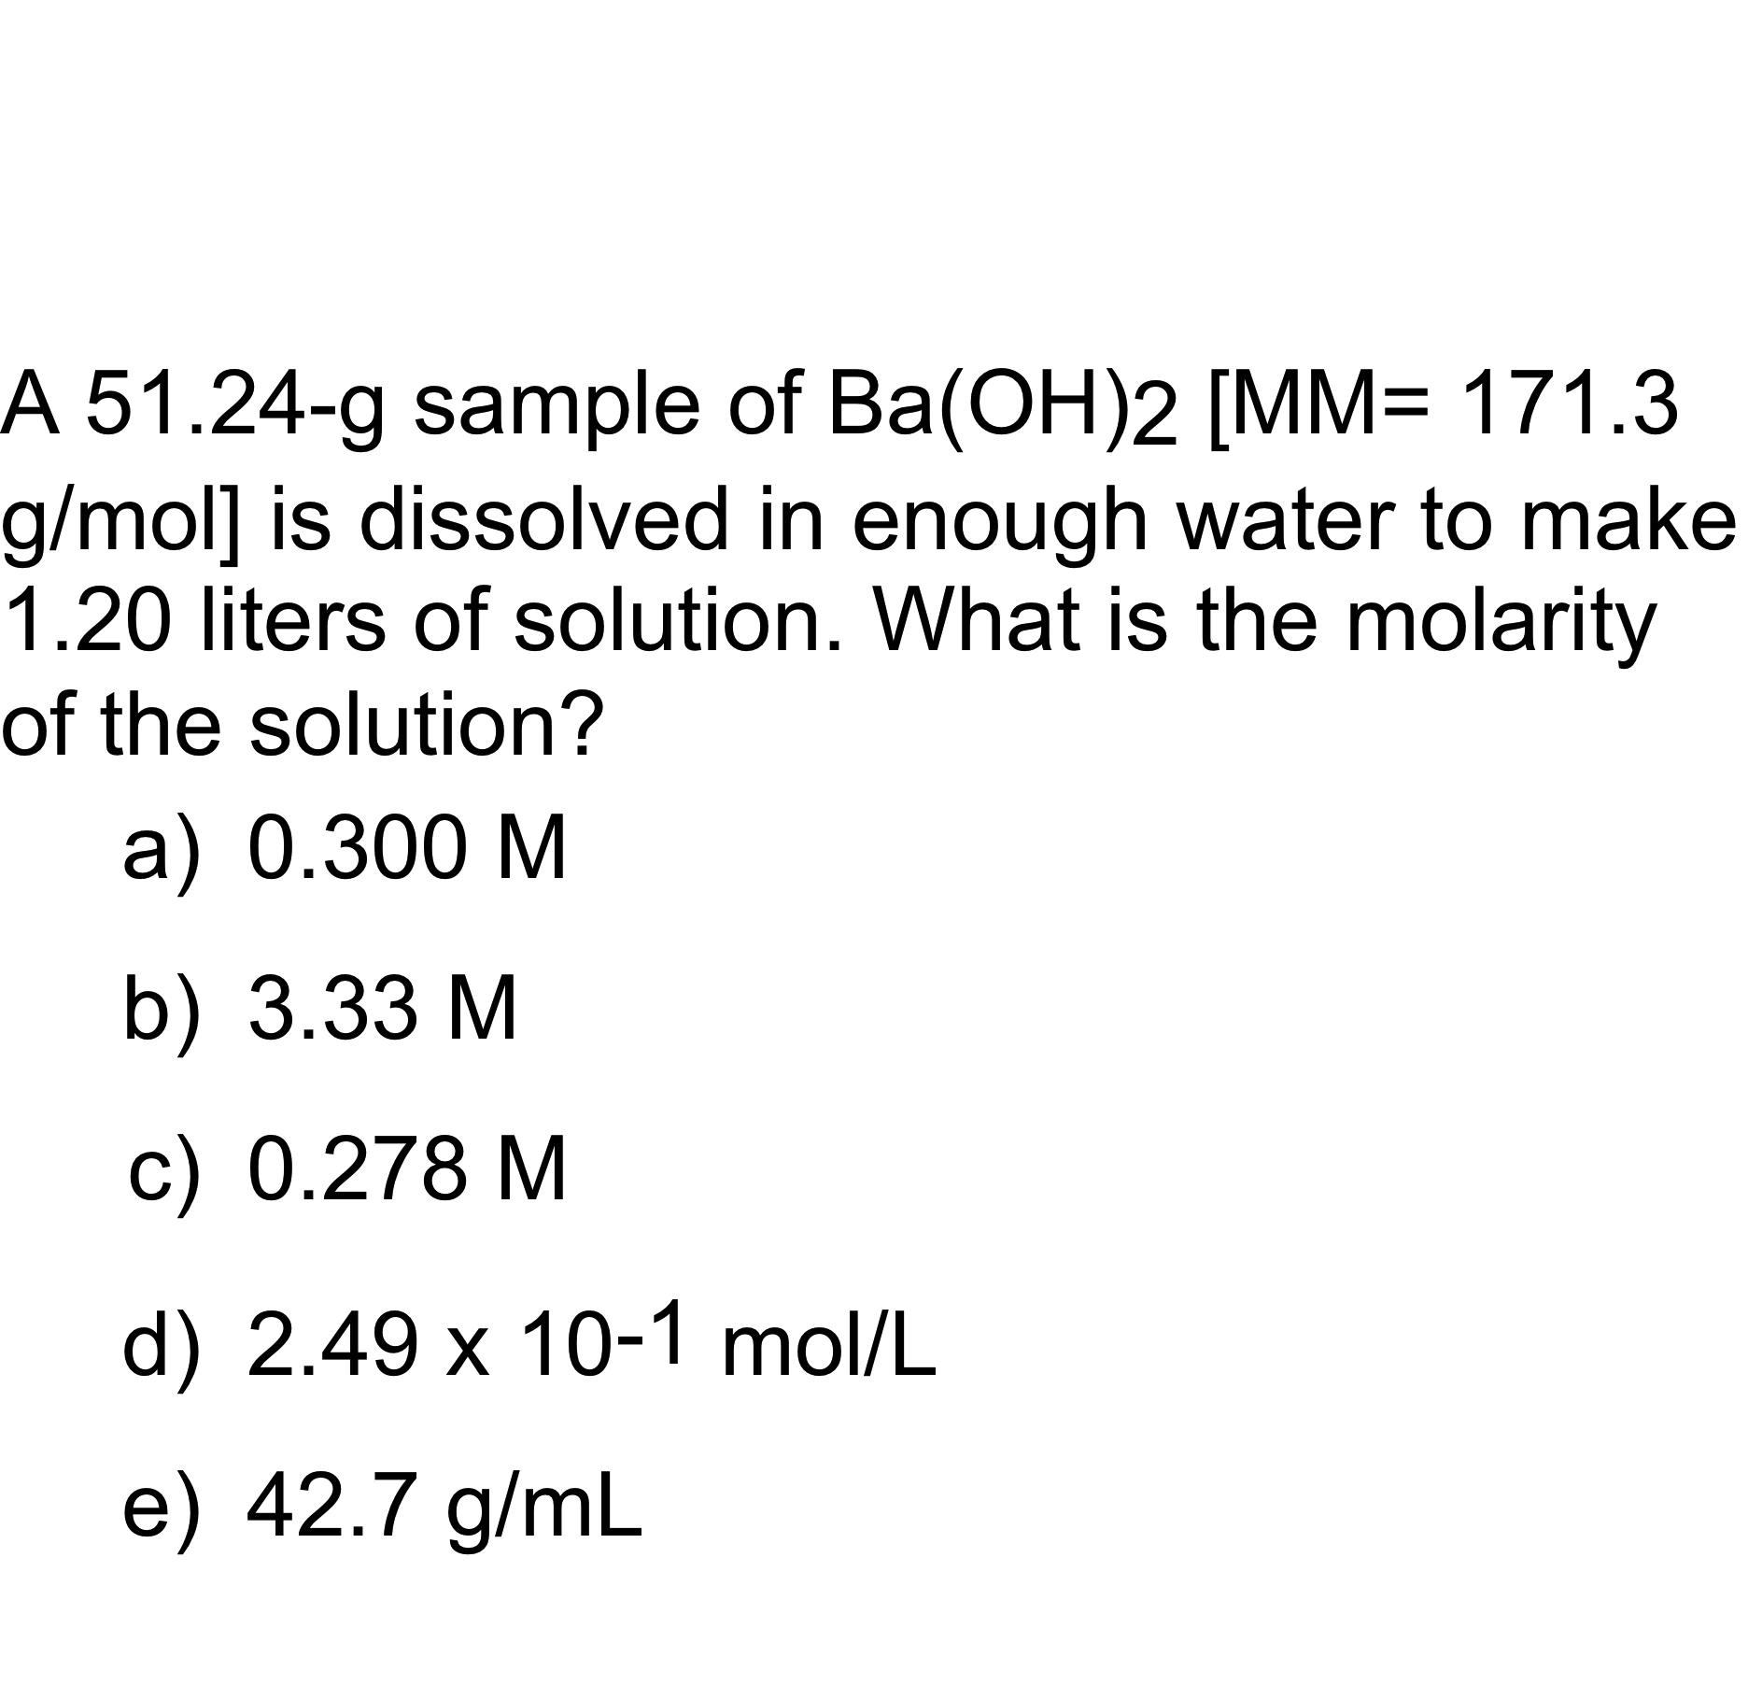
QUESTION

Slide 5

Solution Concentration
The following formula can be used in dilution calculations:
M₁V₁ = M₂V₂
A concentrated stock solution is much easier to prepare and then dilute rather than preparing a dilute solution directly. Concentrated sulfuric acid is 18.0M. What volume would be needed to prepare 250.mL of a 1.50M solution?
V₁ = M₂V₂ / M₁
V₁ = 1.50 M x 250. mL / 18.0 M
V₁ = 20.8 mL

Slide 6
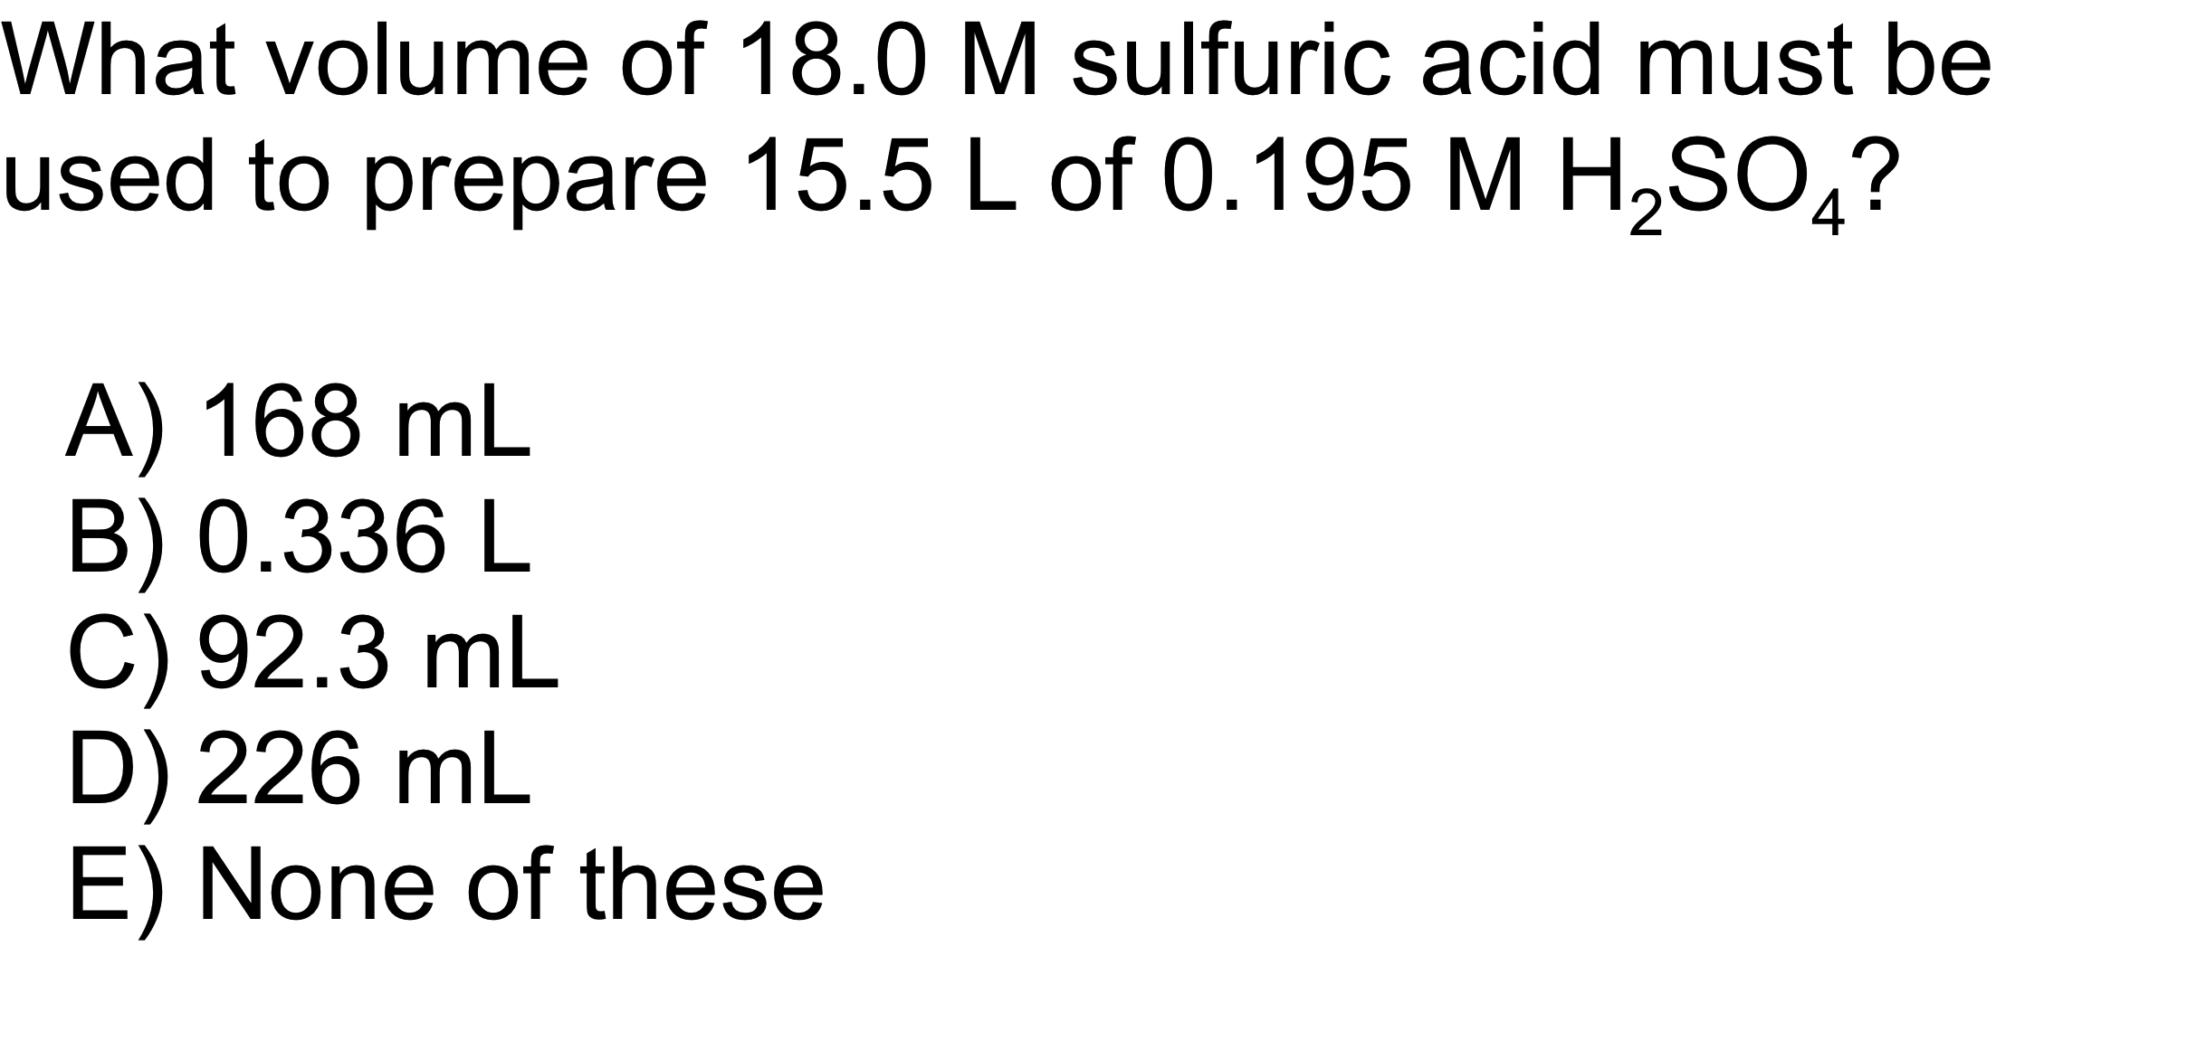
QUESTION

Slide 7
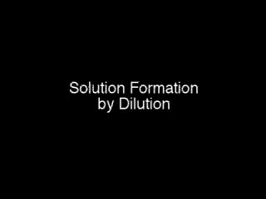
Solution Dilution

Slide 8
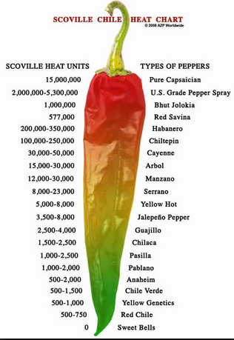
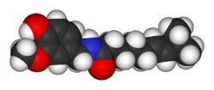
Solution Applications
Scoville Units / Capsaicin
Capsaicin: C₁₈H₂₇NO₃
Carolina Reaper
“Thunderclap Headache”
http://en.wikipedia.org/wiki/Scoville_scale
https://www.youtube.com/watch?v=hrF3jVppfr4
Notes:
reversible cerebral vasoconstriction syndrome (RVS),

Slide 9
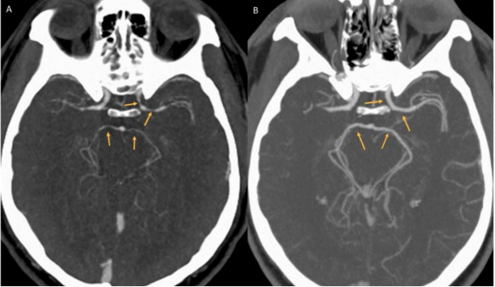
Reversible Cerebral
Vasoconstriction Syndrome (RVS)
Capsaicin: C₁₈H₂₇NO₃
Carolina Reaper
Thunderclap Headache
http://en.wikipedia.org/wiki/Scoville_scale
https://www.youtube.com/watch?v=hrF3jVppfr4
Notes:
reversible cerebral vasoconstriction syndrome (RVS),

Slide 10
QUESTION
What happens to the number of moles of C₁₂H₂₂O₁₁ (sucrose) when 100.0 mL of a 0.20 M solution is diluted to a final concentration
of 0.10 M?
A) The number of moles of C₁₂H₂₂O₁₁ decreases.
B) The number of moles of C₁₂H₂₂O₁₁ increases.
C) The number of moles of C₁₂H₂₂O₁₁ does not change.
D) There is insufficient information to answer the question.

Slide 11
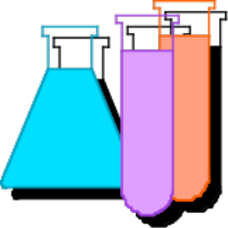
Solution Applications
A solution of barium chloride was prepared by dissolving 26.0287 g in water to make 500.00 mL of solution. What is the concentration of the barium chloride solution? M_{BaCl2} = ?
M_{BaCl2} =
= [26.0287g _{BaCl2} / 500.00mL ][1mol _{BaCl2} / 208.23g _{BaCl2} ] [1000mL / L]
= 0.25000 mol / L

Slide 12
Solution Applications
10.00 mL of this solution was diluted to make exactly 250.00 mL of solution which was then used to react with a solution of potassium sulfate. What is the concentration of the diluted solution. M₂ = ?
    M_{BaCl2} = M₁
    M₂ = M₁V₁ / V₂
    M₂ = 0.25000 M x 10.00 mL / 250.00 mL
    M₂ = 0.010000 M

Slide 13
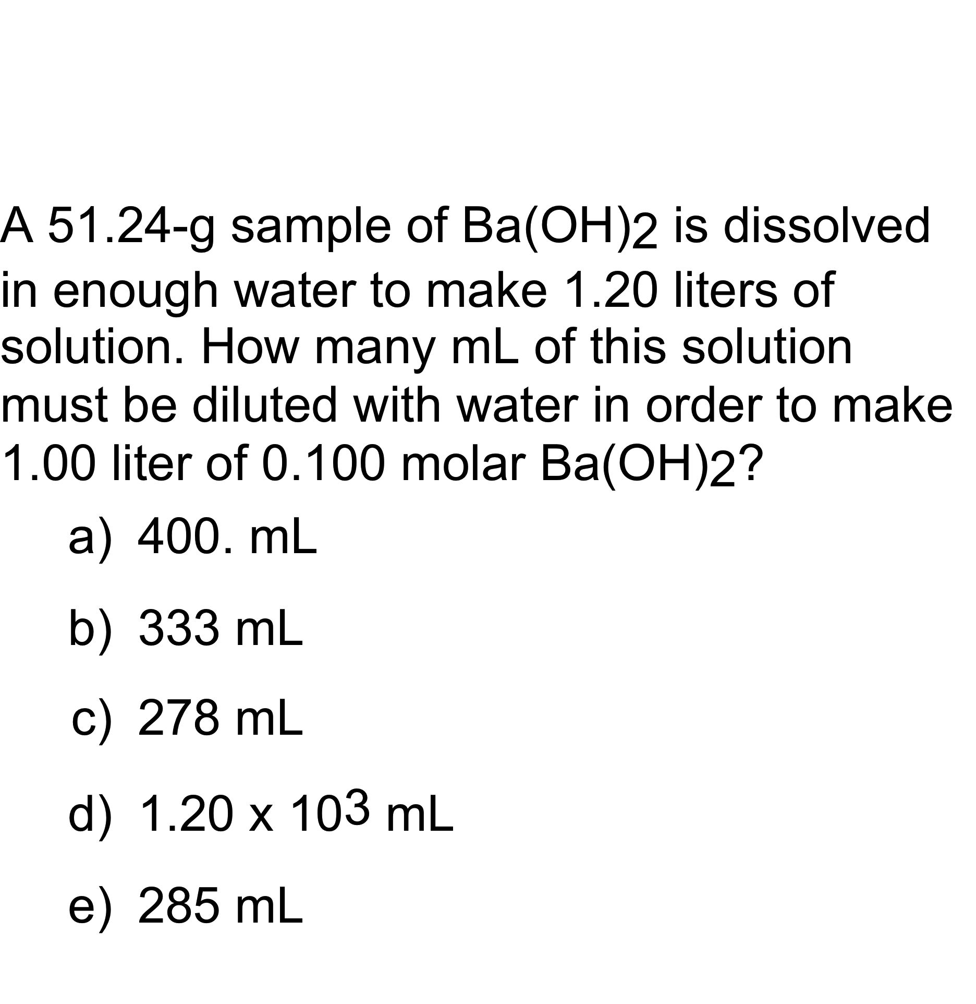
QUESTION

Slide 14
Solution Applications
(Chem 120 Prep)
  20.00 mL of a M₂ = 0.010000 M barium chloride solution required 15.50 mL of the potassium sulfate solution to react completely. M_{K2SO4} = ?
BaCl₂(aq) + K₂SO₄(aq) → ? + ?
BaCl₂(aq) + K₂SO₄ (aq) → 2 KCl(aq) + BaSO₄ (s)
?M_{K2SO4} = [M_{BaCl2}x V_{BaCl2} / V_{K2SO4} ] [? mol_{K2SO4} / ? mol_{BaCl2} ]
0.010000 mol_{BaCl2} x 0.02000 L_{BaCl2} x 1 mol_{K2SO4}
L_{BaCl2} x 0.01550 L_{K2SO4} x 1 mol_{BaCl2}
?M_{K2SO4} =
?M_{K2SO4} = 0.01290 mol_{K2SO4} / L_{K2SO4} = 0.01290 M_{K2SO4}

Slide 15
Solution Applications
How many grams of potassium chloride are produced?
BaCl₂(aq) + K₂SO₄(aq) → ? + ?
BaCl₂(aq) + K₂SO₄ (aq) → 2 KCl(aq) + BaSO₄ (s)
1
?g_{KCl} = 0.010000 mol_{BaCl2} / L_{BaCl2} x 0.02000 L_{BaCl2} X 2 mol_{KCl} / 1 mol_{BaCl2} X
74.55 g_{KCl} /mol_{KCl}
= 0.02982 g_{KCl}

Slide 16
Solution Applications
If 20.00 mL of a 0.10 M solution of barium chloride was reacted with 15.00 mL of a 0.20 M solution of potassium sulfate, what would be the theoretical yield of barium sulfate?
BaCl₂(aq) + K₂SO₄ (aq) → 2 KCl(aq) + BaSO₄ (s)
Which is the Limiting Reagent?
Mol_{BaCl2} = M_{BaCl2}x V_{BaCl2}
= 0.10 mol_{BaCl2} / L_{BaCl2} x 0.02000 L_{BaCl2}
1 mol_{BaCl2}
= 2.0 x 10⁻³
Mol_{K2SO4}= M_{K2SO4}x V_{K2SO4}
= 0.20 mol_{K2SO4} / L_{K2SO4} x 0.01500 L_{K2SO4}
1 mol_{K2SO4}
= 3.0 x 10⁻³
2.0 x 10⁻³ < 3.0 x 10⁻³
2.0 x 10⁻³ mol is limiting

Slide 17
Solution Applications
If 20.00 mL of a 0.10 M solution of barium chloride was reacted with 15.00 mL of a 0.20 M solution of potassium sulfate, what would be the theoretical yield of barium sulfate?
BaCl₂(aq) + K₂SO₄ (aq) → 2 KCl(aq) + BaSO₄ (s)
Must use the limiting reagent:
0.10 mol_{BaCl2} x 0.02000 L_{BaCl2} x 1 mol_{BaSO4} x 233.39 g _{BaSO4}
L_{BaCl2} 1 mol_{BaCl2} mol_{BaSO4}
=
= 0.47 g

Slide 18
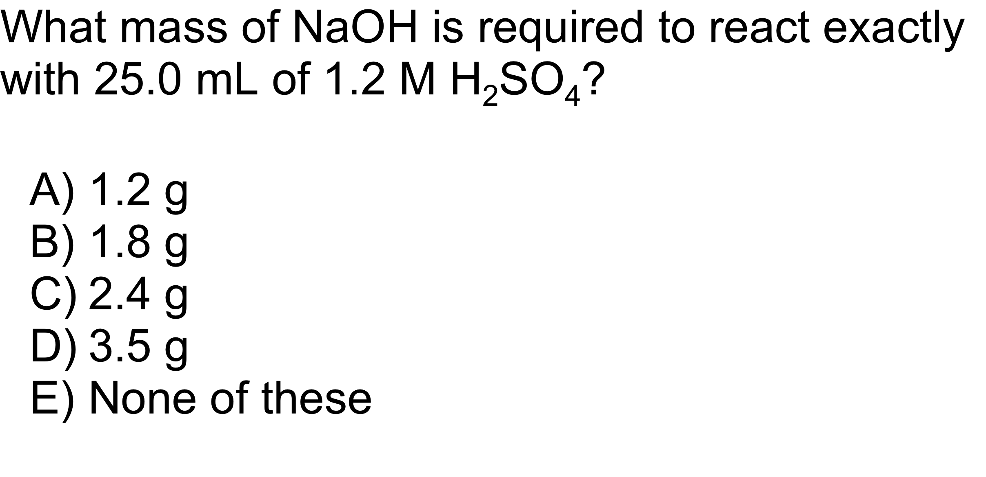
QUESTION

